Slide 1
DEQUE
Saif Hassan

Slide 2
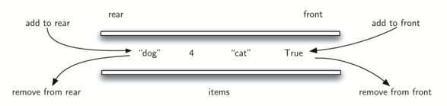
Deque (Double-Ended Queue)

Slide 3
Palindrome using Deque
AddFront()
RemoveFront()
AddRear()
RemoveRear()
How will you solve using Deque?

Slide 4
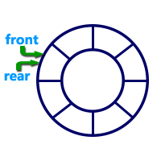
Circular Queue
Insertion
Rear = (rear + 1) mod n
Deletion

